Slide 1
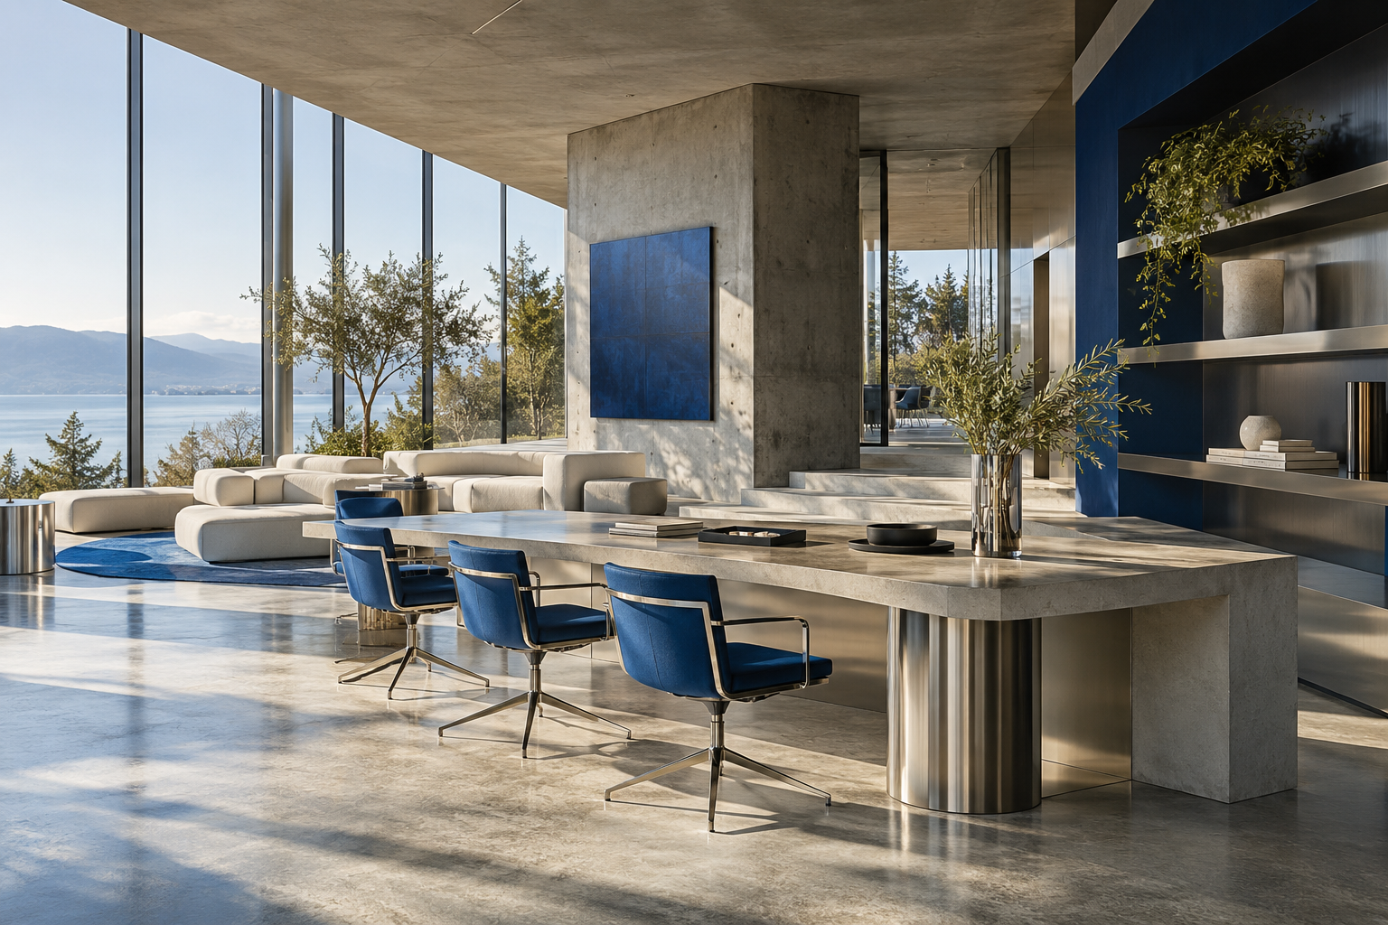
forma
STUDIO
Spaces with
a point of view.
Workplace design. Interior concepts.
Spatial planning.
COMPANY PROFILE / ORIGINAL CONCEPT
Notes:
Original fictional company profile concept by Ryan Richardson. Forma Studio is a demonstration brand; the workspace is an imagined concept, not a completed client project. Image: original Forma concept asset created for this portfolio. Copy aligned with the Forma demonstration website.

Slide 2
A CONSIDERED APPROACH
Start with people.
Make room for possibility.
01 / Understand
02 / Explore
03 / Refine
How will the space be used?
Start with the people, the work
and the everyday routines.
Consider light, movement
and material. Test the ideas
against a clear brief.
Bring the details together.
A coherent direction makes
the next decisions easier.
FORMA STUDIO / FICTIONAL COMPANY PROFILE
02 / 06
Notes:
Original fictional company profile concept by Ryan Richardson. Forma Studio is a demonstration brand; the workspace is an imagined concept, not a completed client project. Image: original Forma concept asset created for this portfolio. Copy aligned with the Forma demonstration website.

Slide 3
WHAT WE DO
From first idea
to final detail.
01
Workplace design
Workspace brief / Layout concepts / Furniture direction
02
Interior concepts
Mood boards / Material palette / Lighting concepts
A practical plan.
A consistent identity.
A more useful space.
03
Spatial planning
Space analysis / Layout options / Design priorities
FORMA STUDIO / FICTIONAL COMPANY PROFILE
03 / 06
Notes:
Original fictional company profile concept by Ryan Richardson. Forma Studio is a demonstration brand; the workspace is an imagined concept, not a completed client project. Image: original Forma concept asset created for this portfolio. Copy aligned with the Forma demonstration website.

Slide 4
A workspace, imagined.
CONCEPT STUDY
NOT A BUILT PROJECT
Daylight, shared space and a confident centrepiece.
FORMA STUDIO / FICTIONAL COMPANY PROFILE
04 / 06
Notes:
Original fictional company profile concept by Ryan Richardson. Forma Studio is a demonstration brand; the workspace is an imagined concept, not a completed client project. Image: original Forma concept asset created for this portfolio. Copy aligned with the Forma demonstration website.

Slide 5
THE PROJECT JOURNEY
01
Listen
A clear route
through the
project.
Define the purpose, priorities and constraints.
02
Explore
Develop a direction and compare options.
03
Resolve
Refine the layout, materials and details.
A shared brief keeps the
important decisions visible.
04
Prepare
Document the agreed concept and next steps.
FORMA STUDIO / FICTIONAL COMPANY PROFILE
05 / 06
Notes:
Original fictional company profile concept by Ryan Richardson. Forma Studio is a demonstration brand; the workspace is an imagined concept, not a completed client project. Image: original Forma concept asset created for this portfolio. Copy aligned with the Forma demonstration website.

Slide 6
FORMA STUDIO
Room for what
comes next.
See the working website, gallery and enquiry demo
in Ryan Richardson’s digital portfolio.
FORMA STUDIO / FICTIONAL COMPANY PROFILE
06 / 06
Notes:
Original fictional company profile concept by Ryan Richardson. Forma Studio is a demonstration brand; the workspace is an imagined concept, not a completed client project. Image: original Forma concept asset created for this portfolio. Copy aligned with the Forma demonstration website.

